Slide 1
Detecting Stale Petrol Pumps using Probe Data

Slide 2
Solution Approach:
Clustering with Explainable AI (XAI)
Rule based- Spatial Outlier Detection and Adaptive Buffering for Stale Petrol Station Identification

Slide 3
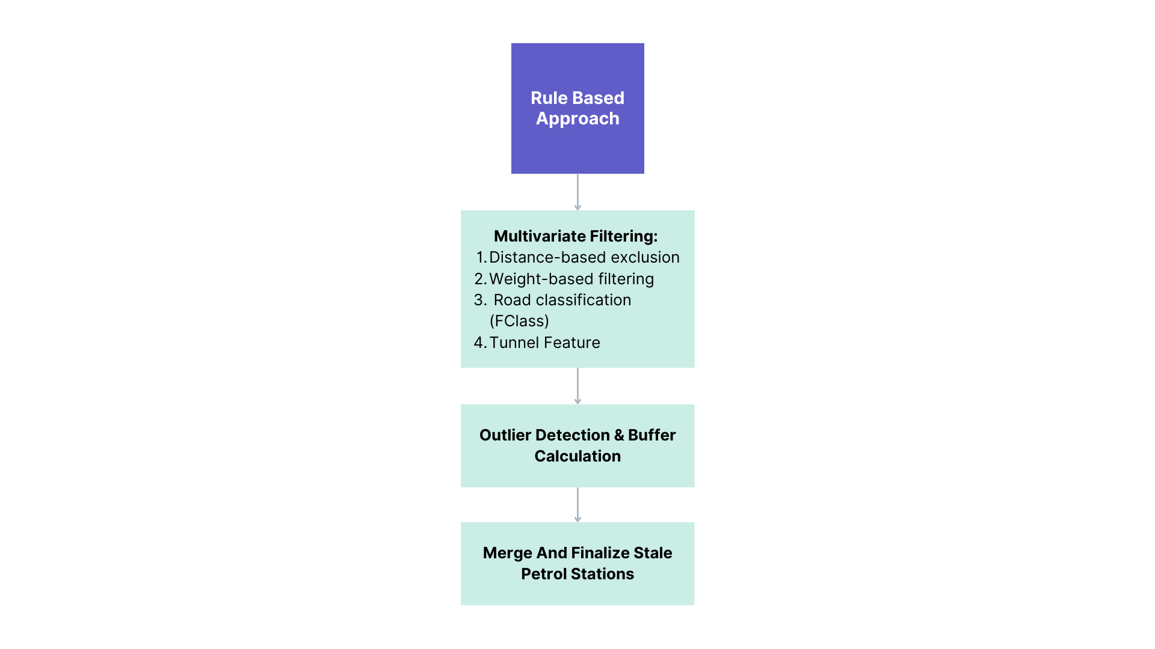
Solution

Slide 4
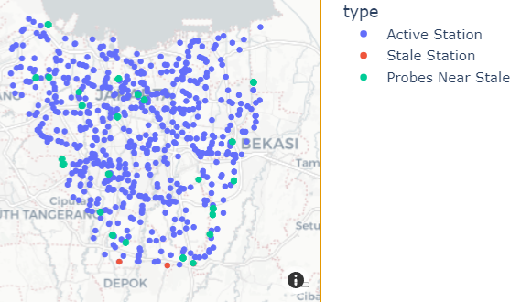
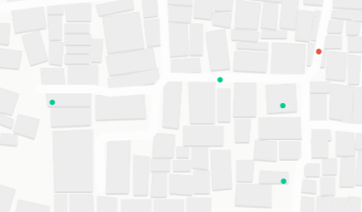
Results - Rule Based Approach

Slide 5
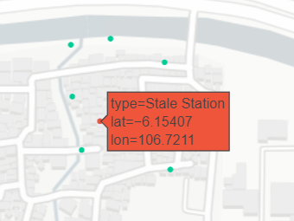
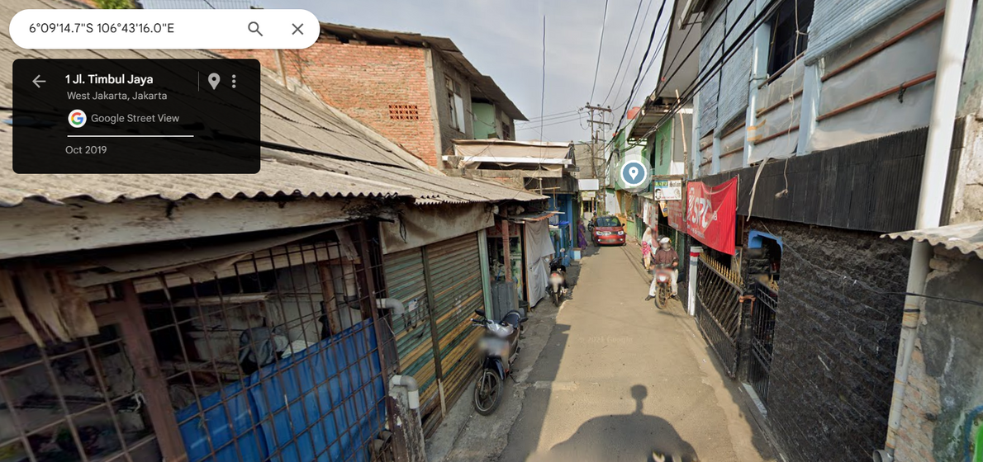
Results - Rule Based Approach

Slide 6
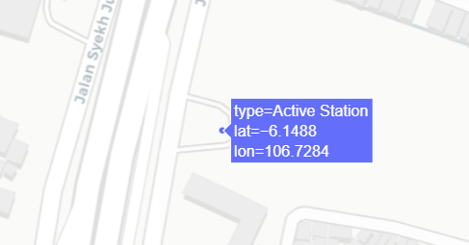
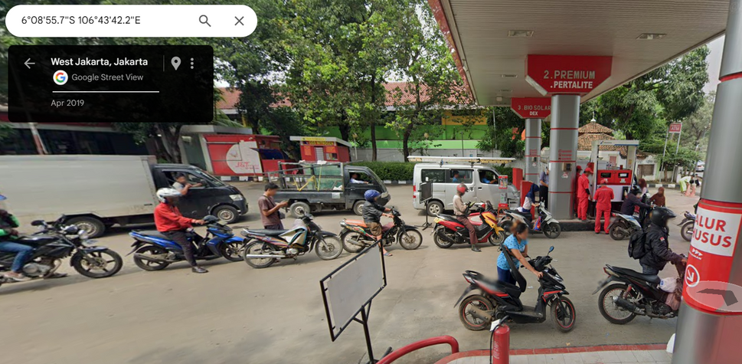
Results - Rule Based Approach

Slide 7
Anomaly based- Approach
Workflow:
Data cleaning
Data normalization
Fine-tuned Isolation Forest model development

Slide 8
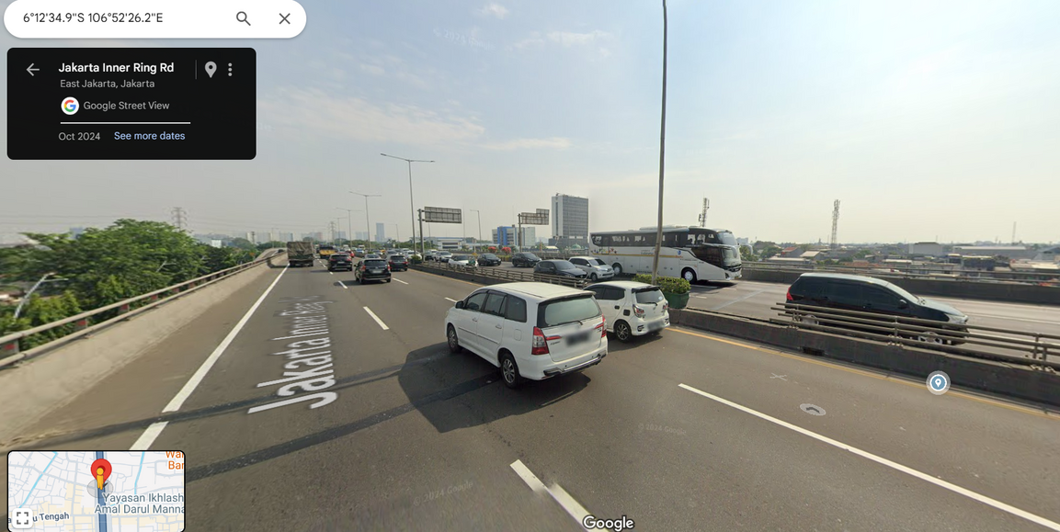
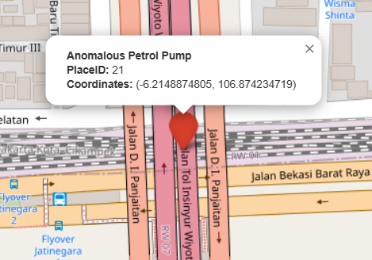
Results- Isolation Forest

Slide 9
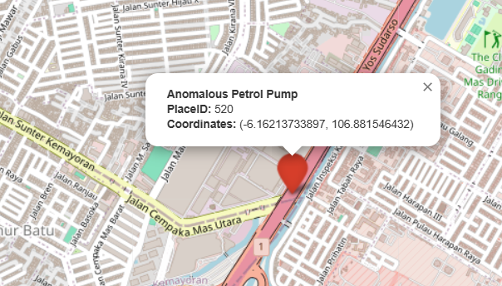
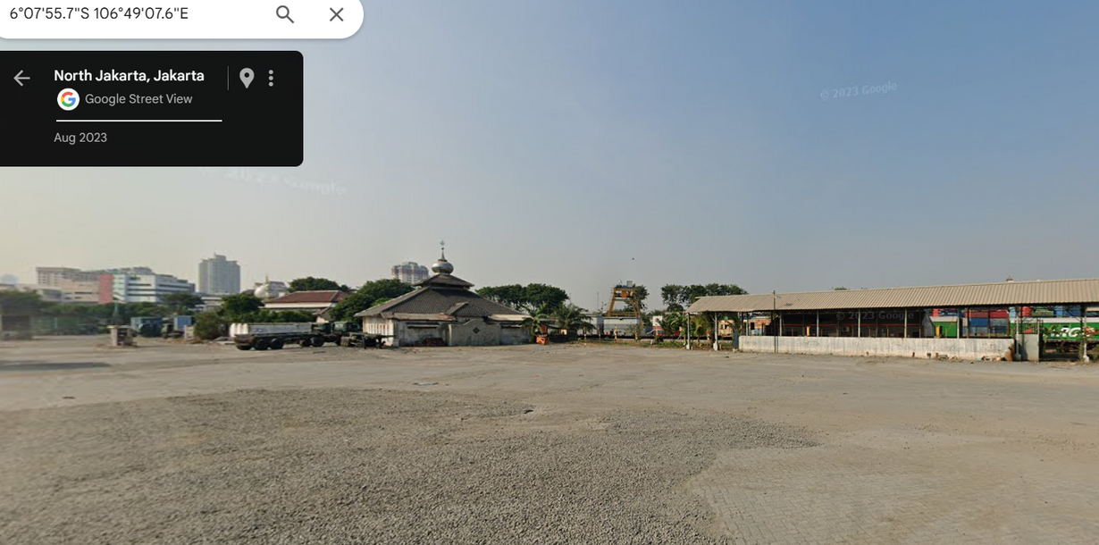
Results- Isolation Forest

Slide 10
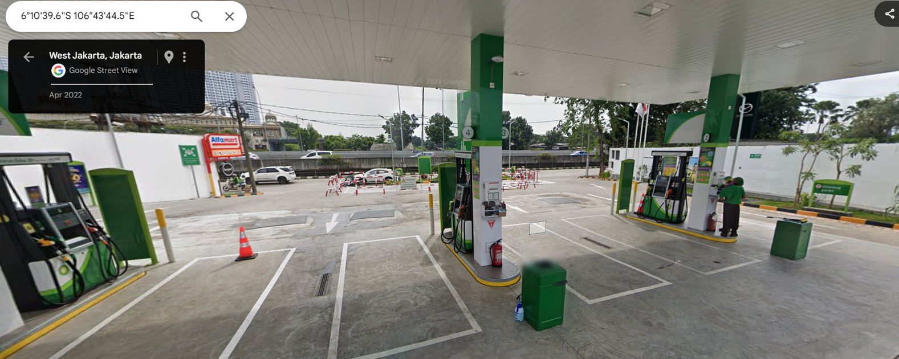
Non-stale petrol pumps
Place id 337

Slide 11
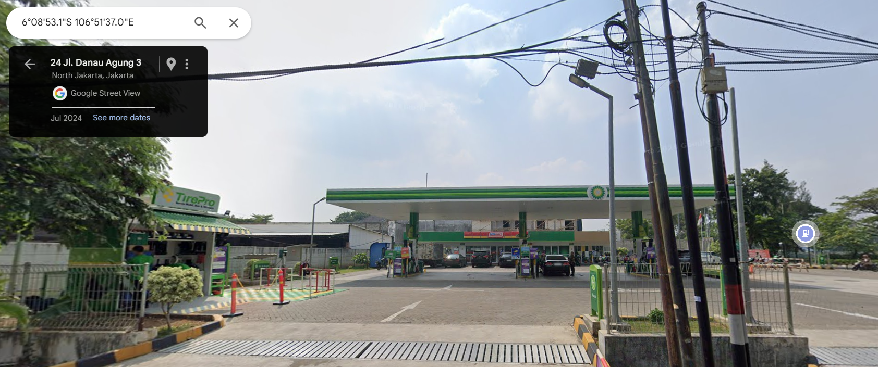
Non-stale petrol pumps
Place id 343

Slide 12
Which approach is better ??
Why our solution is better
Anomaly detection with XAI:
Scalability
Trainable model
Different locations different rules
Model can be updated frequently
Automation
Geospatial tools like Qgis not required
Adaptability to new features

